Slide 1

What You Need to Know About Windows Containers and Kubernetes to Ace the AZ800 and AZ801 Exams!
Vinicius Apolinario
Sr. Cloud Advocate
Microsoft
@vrapolinario

Slide 2
Exam AZ-800: Administering Windows Server Hybrid Core Infrastructure
Skills measured
Deploy and manage AD DS in on-premises and cloud environments (30–35%)
Manage Windows Servers and workloads in a hybrid environment (10–15%)
Manage virtual machines and containers (15–20%)
Implement and manage an on-premises and hybrid networking infrastructure (15–20%)
Manage storage and file services (15–20%)

Slide 3
What is a container?
Notes:
9 MIN

Slide 4
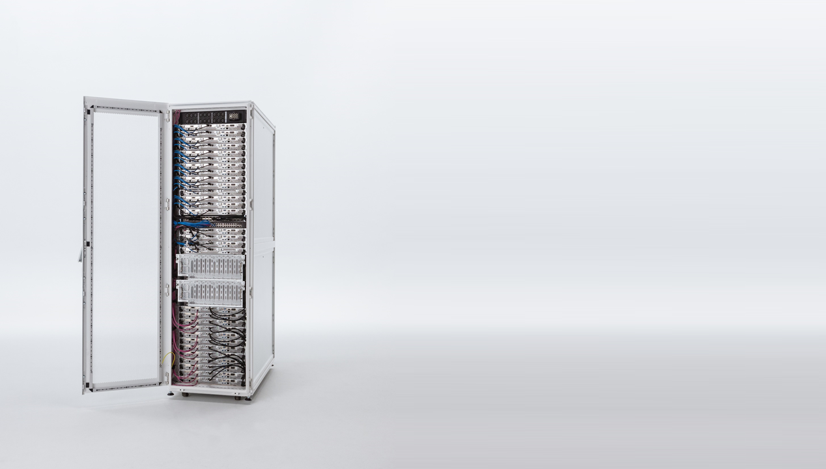
OS
Applications
Services
Kernel
Hardware

Slide 5
“user space”
OS
Applications
Services
Kernel
Hardware
“kernel space”

Slide 6
Container
Container
OS
Applications
Services
Applications
Services
Applications
Services
Kernel
Hardware

Slide 7
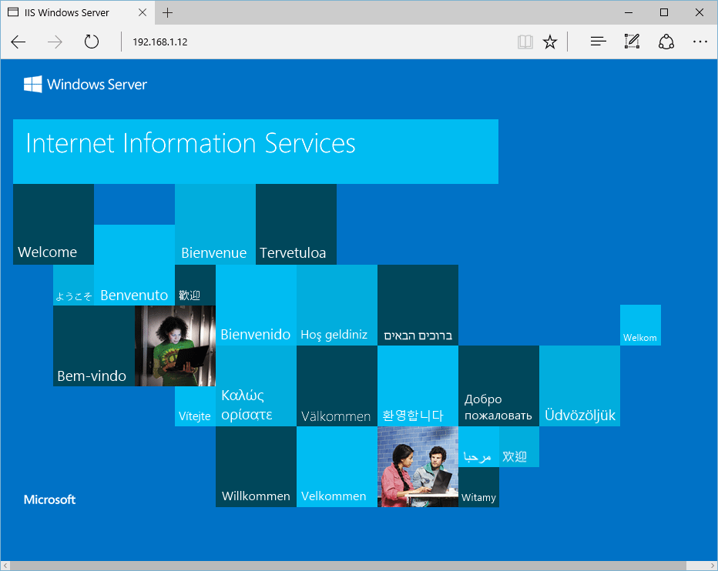
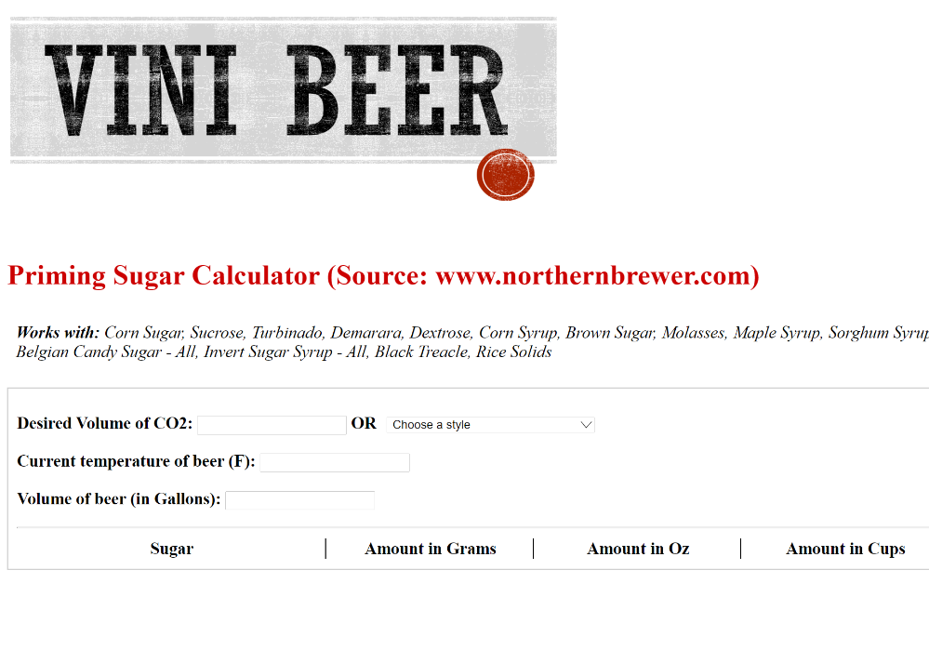
Example: IIS
Container
Container
OS
Applications
Services
My-Website
w3svc.exe
Other-Site
w3svc.exe
Kernel
Hardware

Slide 8
Demo: Building an IIS web site with Windows containers

Slide 9
VMs vs. Containers
Feature | VM | Container
Isolation | Provides complete isolation from the host OS and other VMs. | Provides lightweight isolation from the host and other containers.
OS | Runs a complete OS including the kernel. | Only runs the user mode portion of an OS.
Guest compatibility | Able to run any supported OS inside the VM | Windows containers require matching host and container OS versions. (Please see isolation mode for more details and alternatives)
Deployment | Deployed by using Hyper-V manager or other VM management tools. | Deployed and managed by using Docker or another container runtime. Multiple containers can be deployed by using an orchestrator such as Kubernetes.
Persistent storage | Uses virtual hard disk files or Server Message Block (SMB) share. | Data doesn't persist when a container no longer exists. To persist data in a container with Windows Server, it's required to use persistent storage.
Load balancing and high availability | Uses a Windows failover cluster or Windows load balancer to move VMs as needed and support higher volume. | Uses a container orchestrator to automatically start and stop containers, auto-scale, and support additional traffic.
Networking | Uses virtual network adapters. | Different networking options are available depending on the scenario. Default is a Network Address Translation (NAT) network that uses an internal switch and maps ports from host to container.

Slide 10
Kubernetes?
Notes:
9 MIN

Slide 11

How Kubernetes works (A user point of view)

Slide 12
sample-app.yaml
apiVersion: apps/v1
kind: Deployment
metadata:
name: sample-app
labels:
app: sample-app
spec:
replicas: 1
template:
metadata:
name: sample-app
labels:
app: sample-app
spec:
nodeSelector:
"kubernetes.io/os": windows
containers:
- name: sample-app
image: mcr.microsoft.com/windows/servercore/iis:windowsservercore-ltsc2022
resources:
limits:
cpu: 1
memory: 800M
requests:
cpu: .1
memory: 300M
ports:
- containerPort: 80
selector:
matchLabels:
app: sample-app
Deployment
Pod
Container

Slide 13
sample-app.yaml
apiVersion: apps/v1
kind: Deployment
metadata:
name: sample-app
labels:
app: sample-app
spec:
replicas: 2
template:
metadata:
name: sample-app
labels:
app: sample-app
spec:
nodeSelector:
"kubernetes.io/os": windows
containers:
- name: sample-app
image: mcr.microsoft.com/windows/servercore/iis:windowsservercore-ltsc2022
resources:
limits:
cpu: 1
memory: 800M
requests:
cpu: .1
memory: 300M
ports:
- containerPort: 80
selector:
matchLabels:
app: sample-app
Deployment
Pod
Container

Slide 14
Deployment
Pod
Pod
Container
Container

Slide 15
service.yaml
apiVersion: v1
kind: Service
metadata:
name: sample-app
spec:
type: LoadBalancer
ports:
- protocol: TCP
port: 80
selector:
app: sample-app
Deployment
Pod
Pod
Container
Container
Service

Slide 16
Sample-app
Deployment
Pod
Pod
Pod
Container
Container
Container
Service

Slide 17
Sample-app
Deployment
ConfigMap
DB connection
Other app config
Pod
Pod
Pod
Container
Container
Container
DB
Secret
Username
Password
Service

Slide 18
Namespace
Sample-app
Deployment
ConfigMap
DB connection
Other app config
Pod
Pod
Pod
Container
Container
Container
DB
Secret
Username
Password
Service

Slide 19
Kubernetes architecture (An admin point of view)

Slide 20
Internet
Kubernetes control
Worker node
kubelet
kube-proxy
Container runtime
Master node
Prod
Prod
API server
Pods
Pods
-controller-manager
-scheduler
Worker node
kubelet
kube-proxy
replication, namespace, serviceaccounts, etc.
etcd
Container runtime
Prod
Prod
Pods
Pods

Slide 21
Demo: Deploying a Windows app on Kubernetes

Slide 22
Exam AZ-801: Configuring Windows Server Hybrid Advanced Services
Skills measured
Secure Windows Server on-premises and hybrid infrastructures (25–30%)
Implement and manage Windows Server high availability (10–15%)
Implement disaster recovery (10–15%)
Migrate servers and workloads (20–25%)
Monitor and troubleshoot Windows Server environments (20–25%)

Slide 23
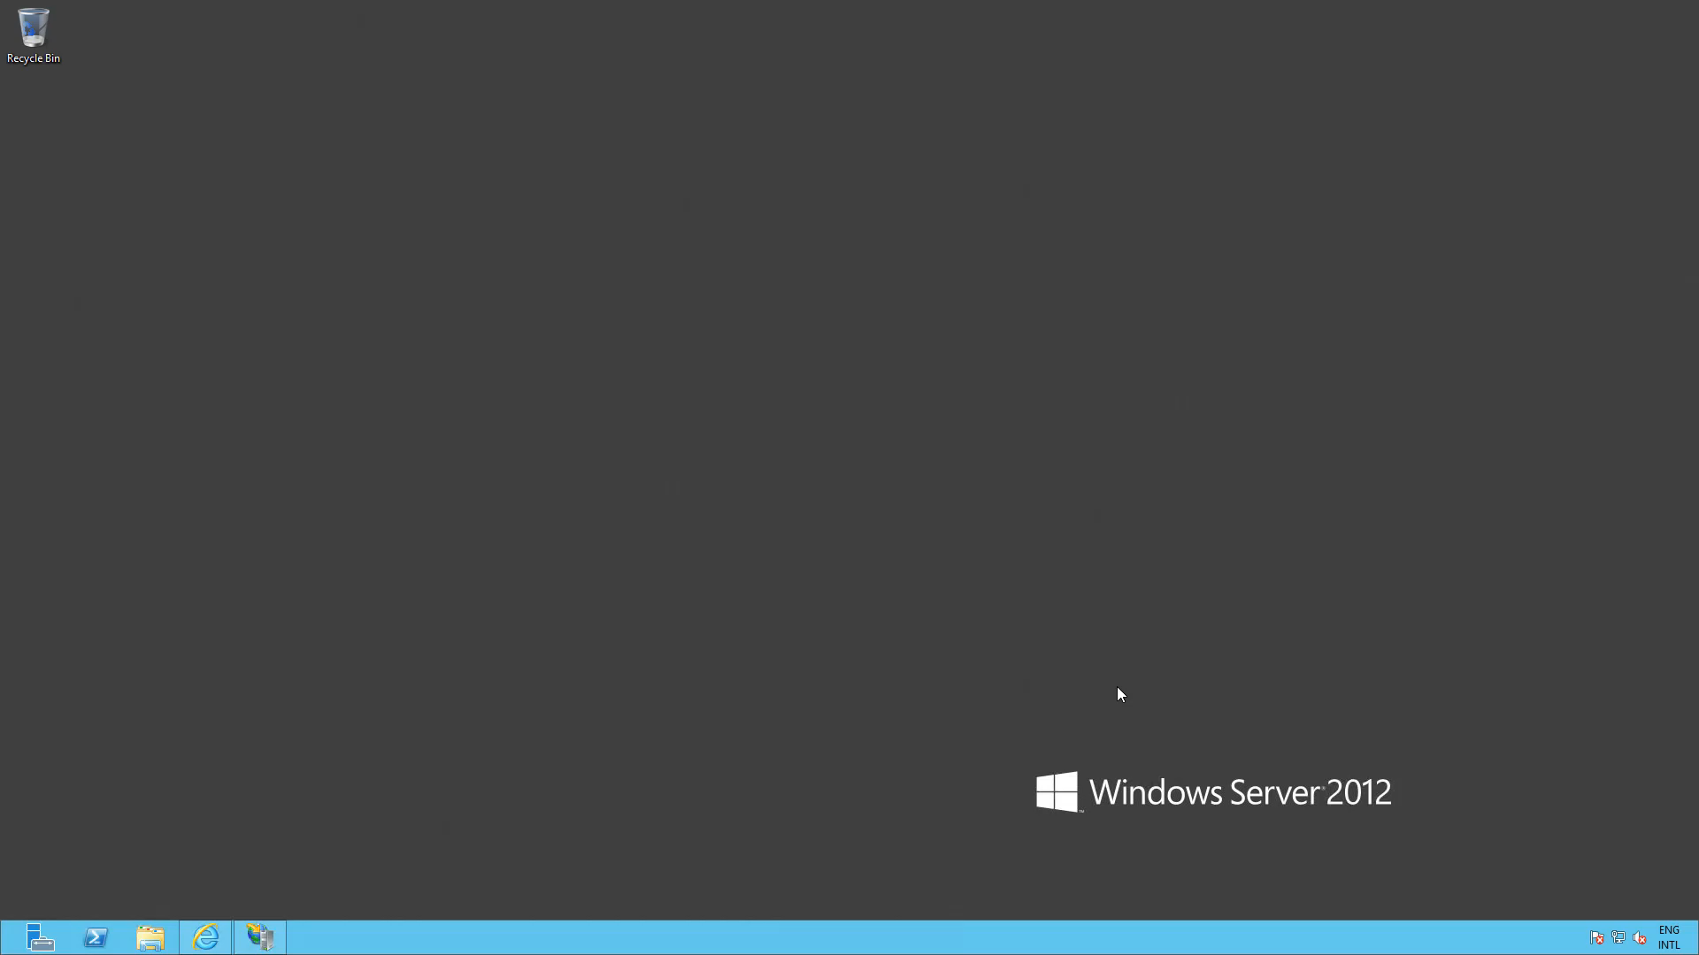

Slide 24
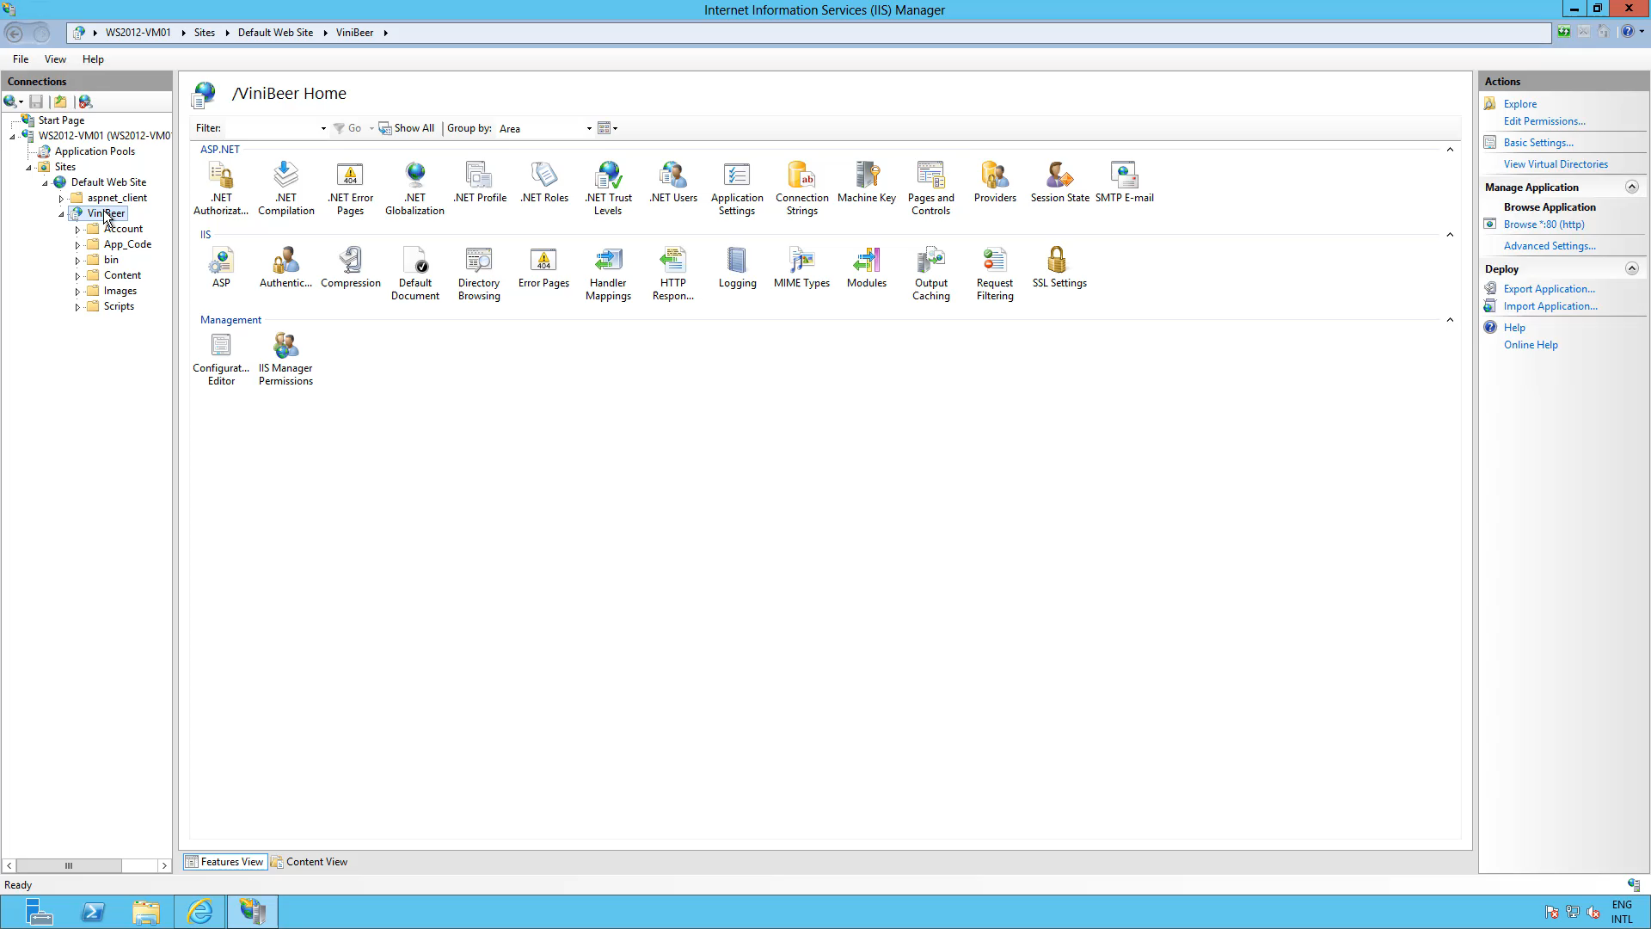

Slide 25
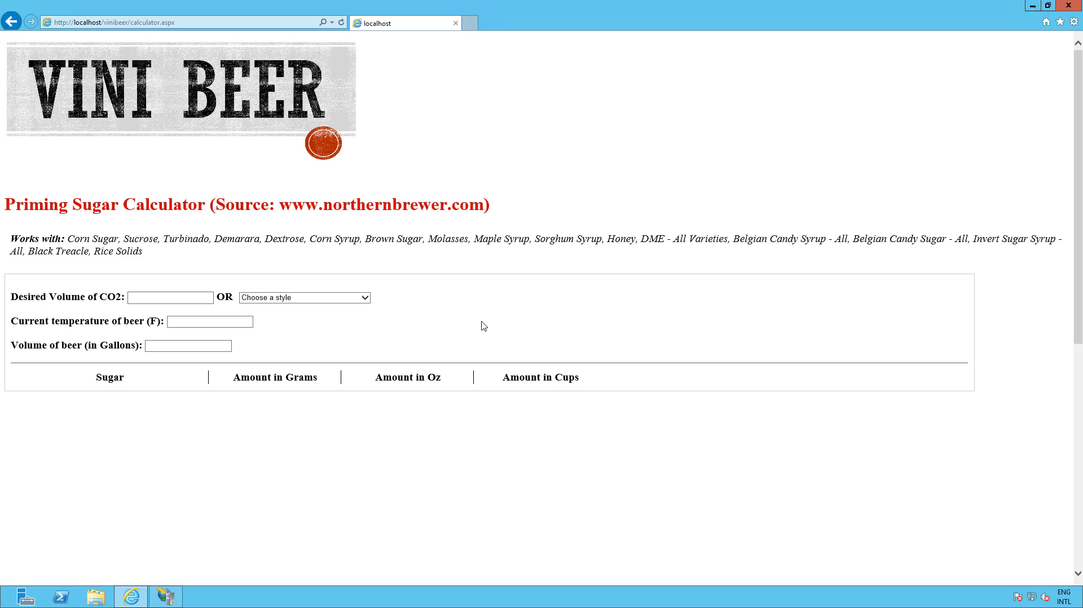

Slide 26
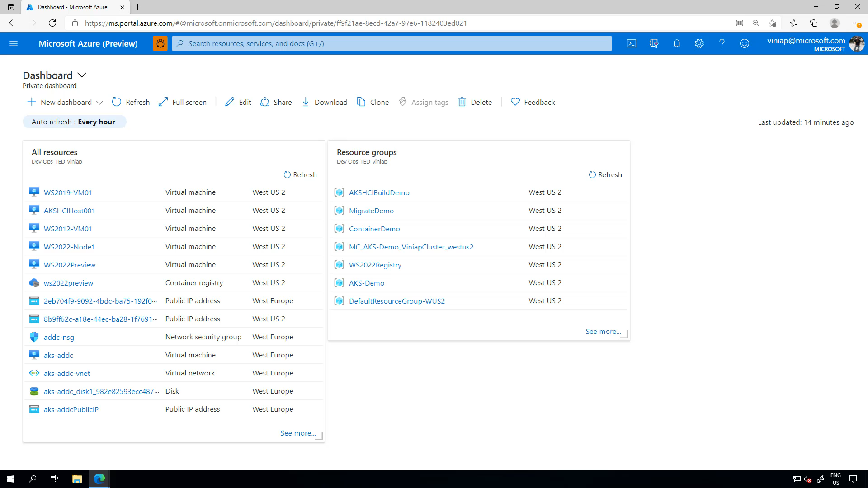

Slide 27
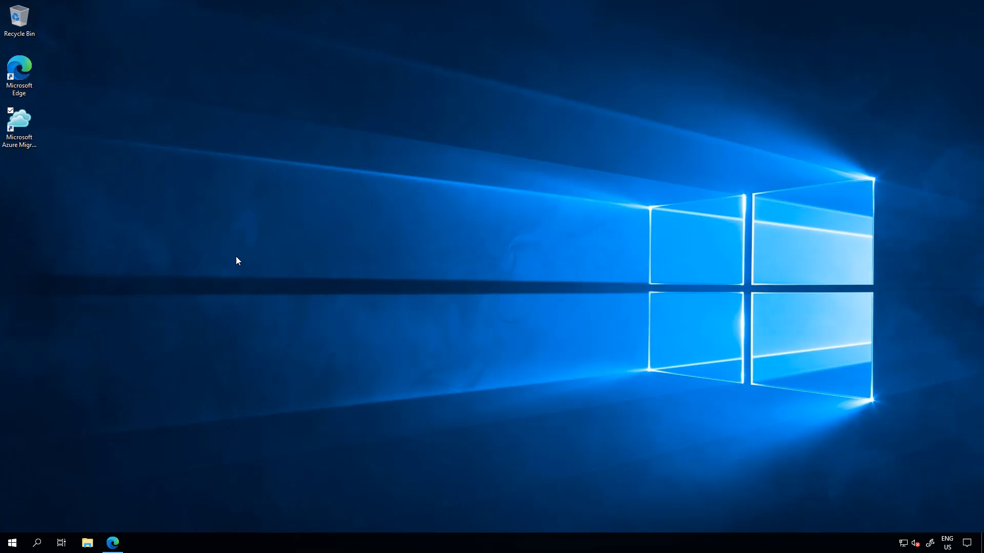

Slide 28
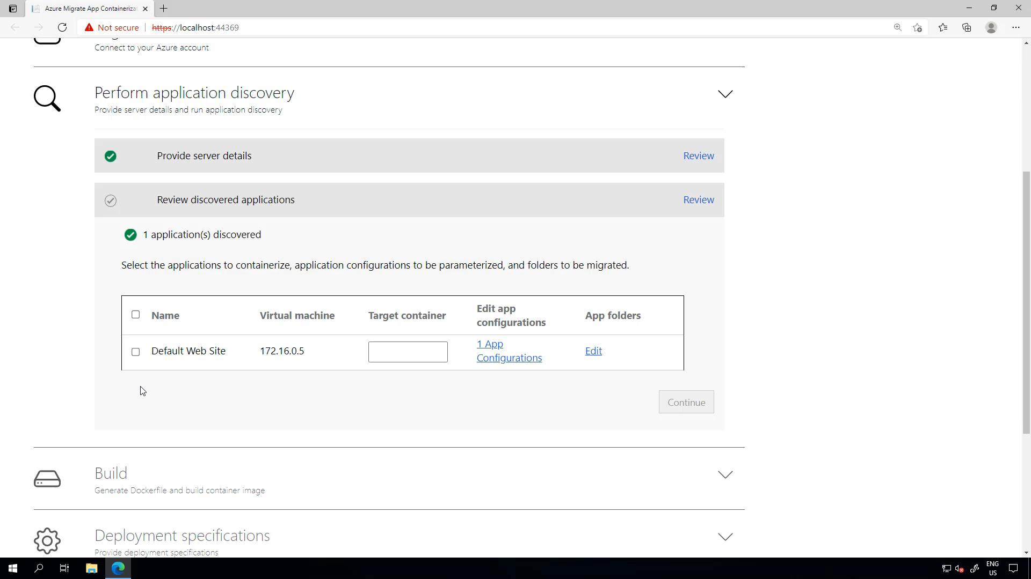

Slide 29
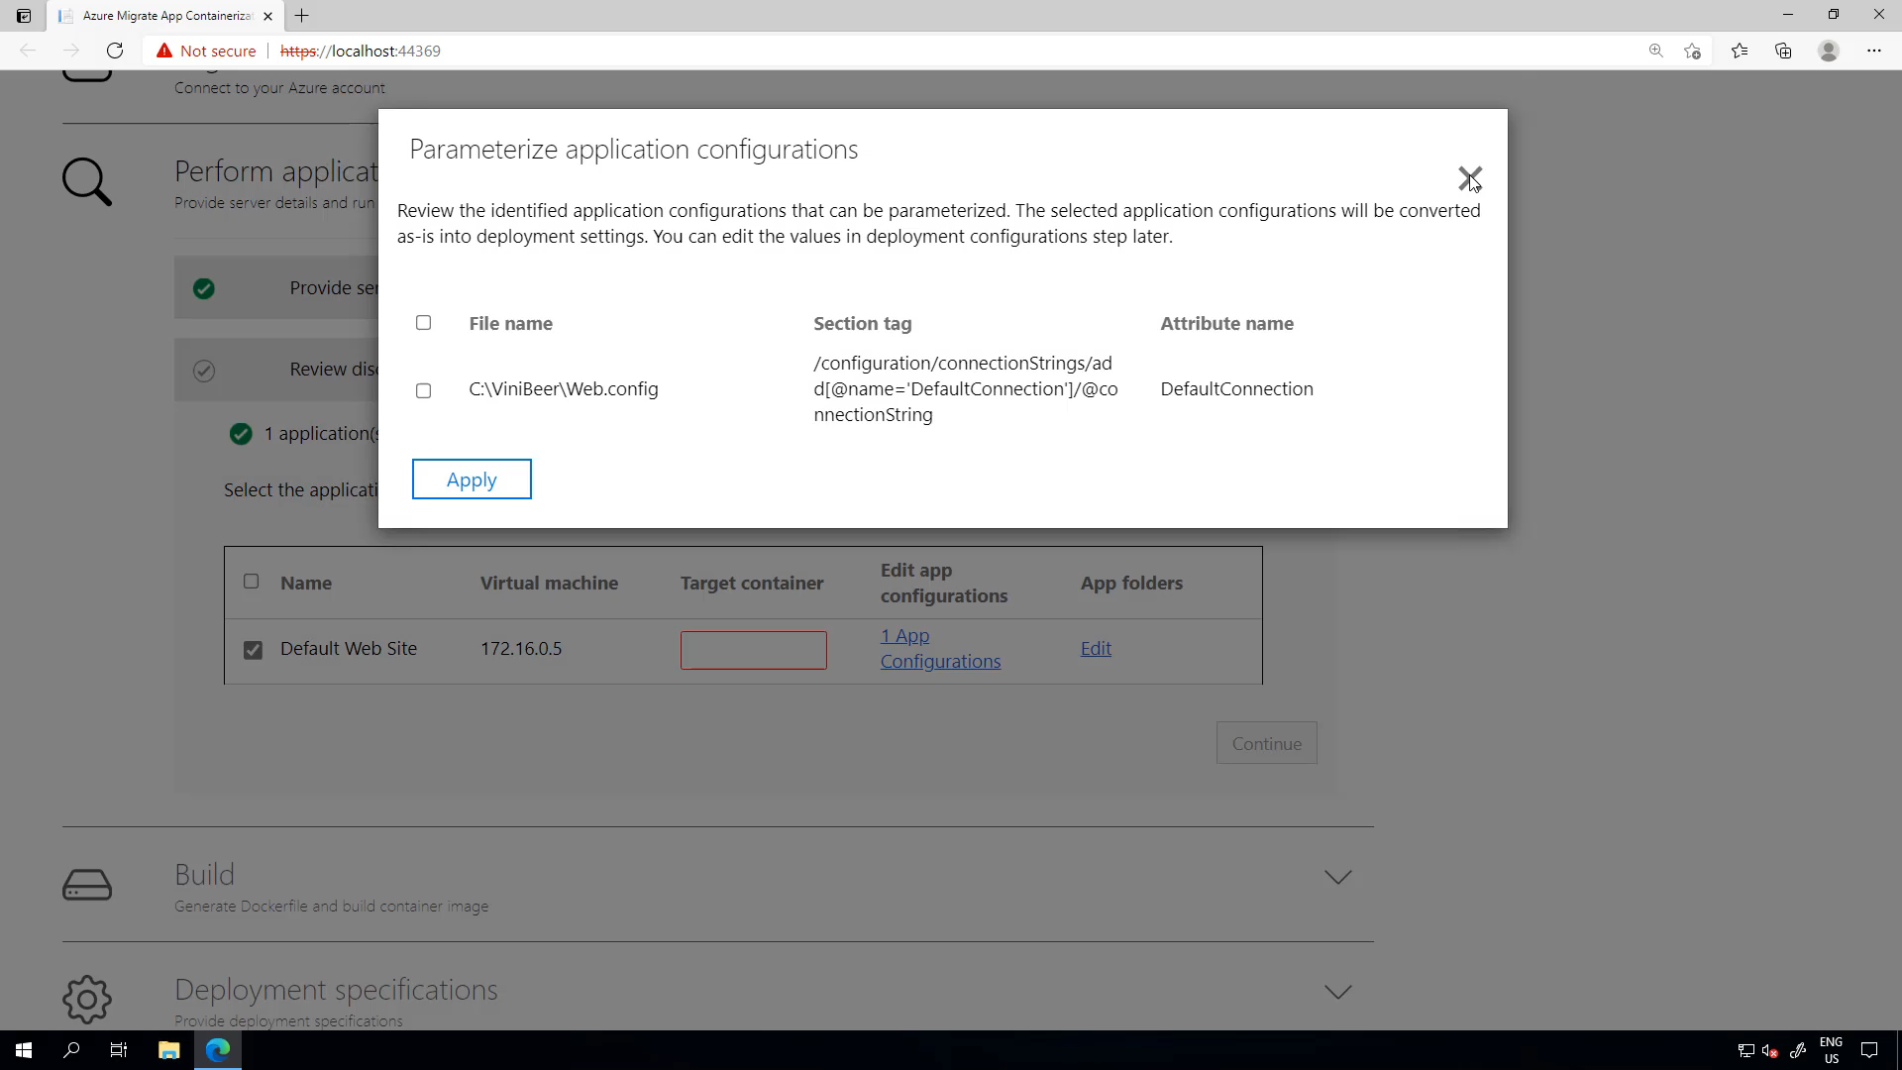

Slide 30
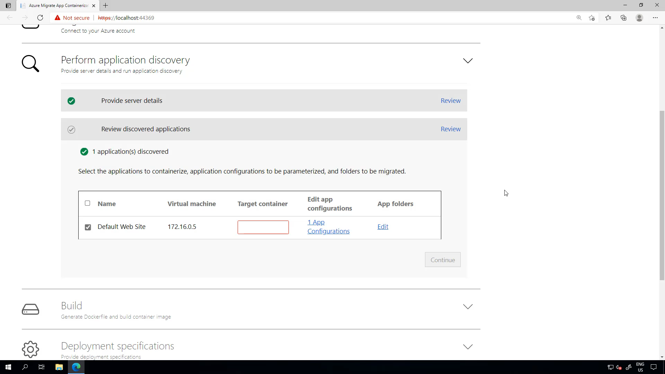

Slide 31
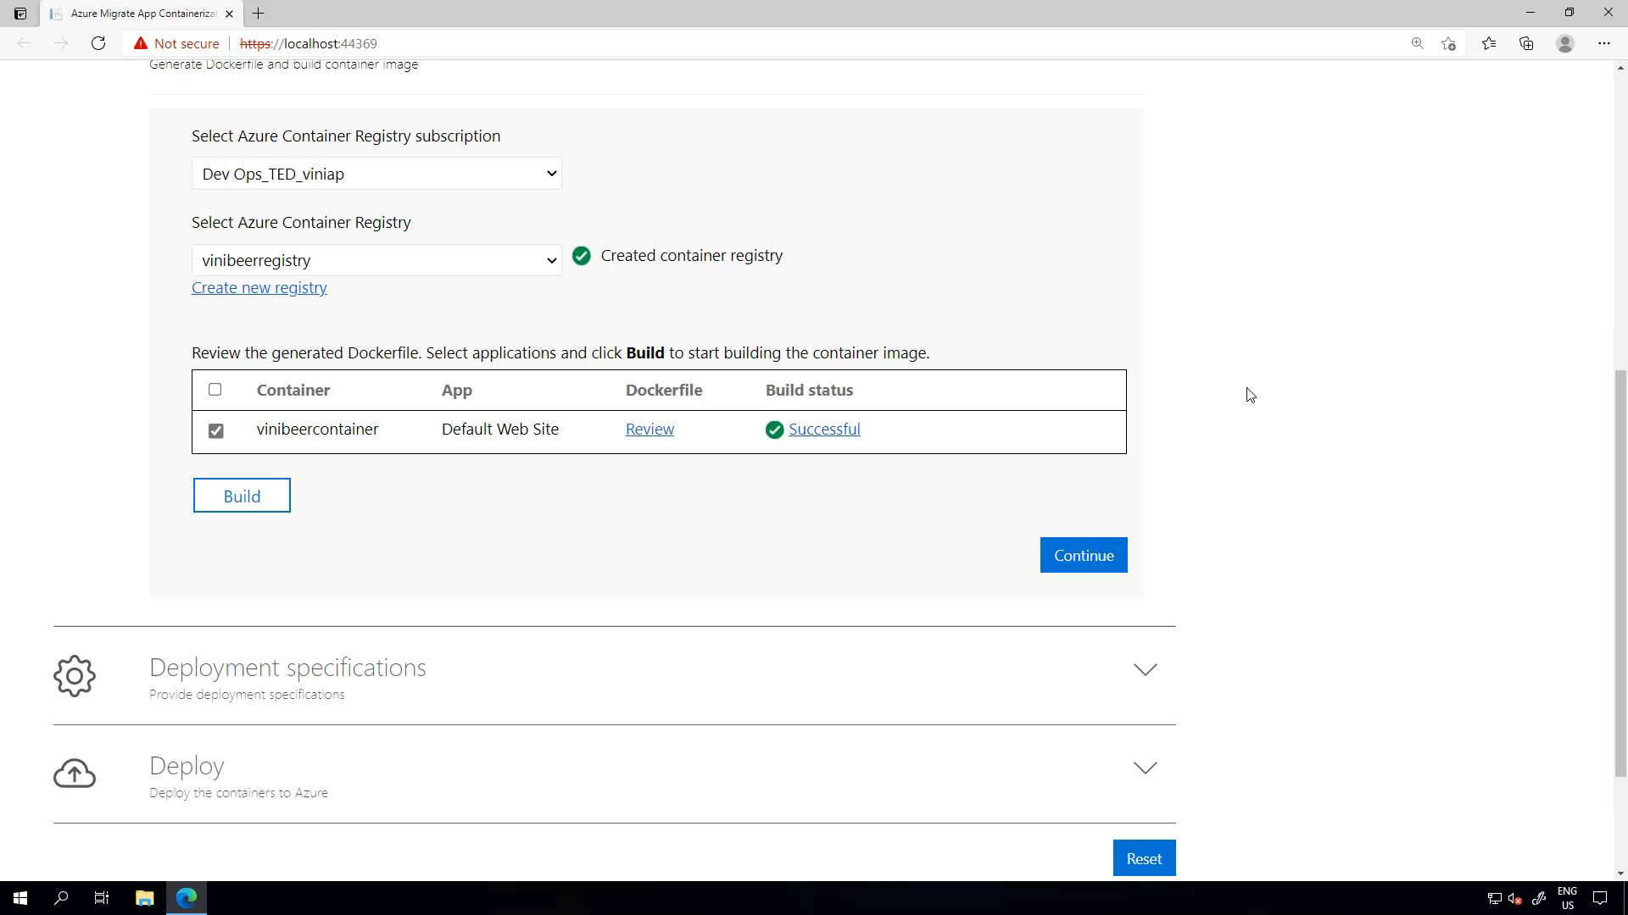

Slide 32
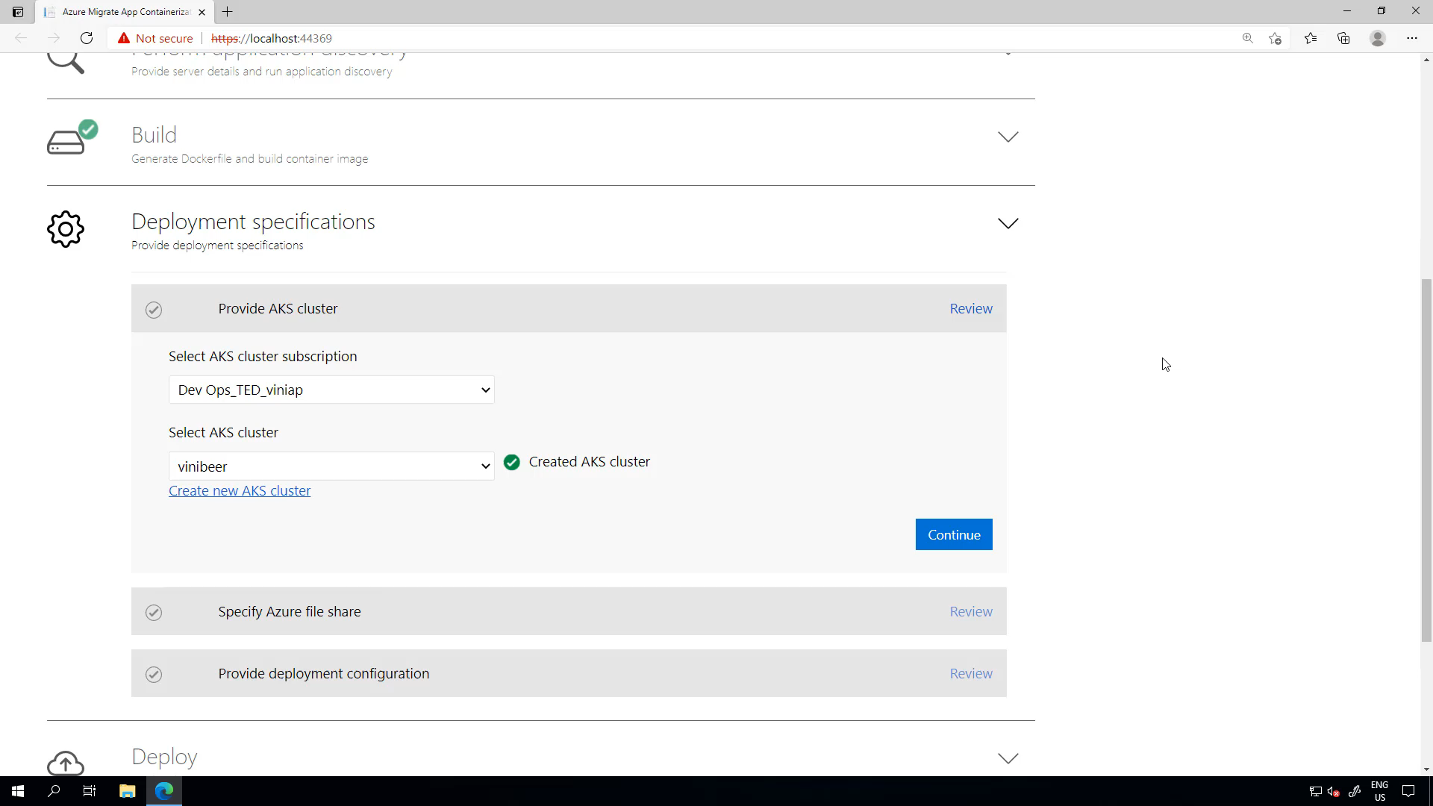

Slide 33
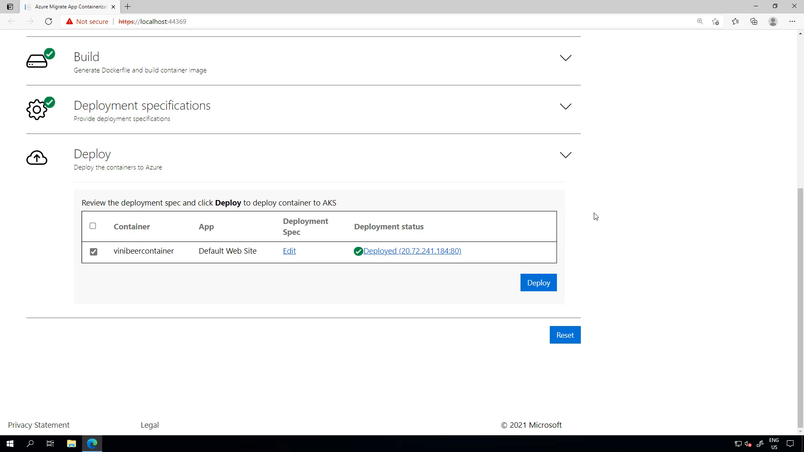

Slide 34
Resources
aka.ms/containers
Learn more about Windows containers
aka.ms/k8sLearning What is Kubernetes
aka.ms/WinContainersPath
Learning Path: Deploy, manage, and monitor Windows containers on Azure Kubernetes Service

Slide 35

Thank you!
Vinicius Apolinario
Sr. Cloud Advocate
Microsoft
@vrapolinario
Session Survey

